Slide 1
GITHUB
dac.html
github.ipynb
[For Beginners!]
DACademy session #1
Basic GitHub + Intro to Python [1]
Discover How to Share, Collaborate,
and Showcase Your Projects!
}
SIM Data Analytics Club

Slide 2
dac.html
github.ipynb
What is GitHub?
GitHub is a platform to store and share your coding projects online.
SIM Data Analytics Club

Slide 3
dac.html
github.ipynb
Key Features of GitHub
A cloud platform to store, share, and collaborate on coding projects
Your digital workspace for organizing and tracking code changes
Efficient project management with a history of changes and collaboration through pull requests
Create repositories to store and share your projects
Easily work with others, receive feedback, and contribute to open-source projects
SIM Data Analytics Club

Slide 4
dac.html
github.ipynb
Share your code with others
Collaborate on projects with your team
Showcase your projects like an online portfolio
Contribute to open-source projects and build your skills!
Why use GitHub?
SIM Data Analytics Club

Slide 5
dac.html
github.ipynb
Basic Concepts to Know
Definitions
Repository (Repo): A project folder that stores your code and files.
Commit: A snapshot of your code at a specific point in time.
Branch: A separate version of your project where you can make changes without affecting the main code.
Pull Request: A way to propose changes to the main project.
SIM Data Analytics Club

Slide 6
dac.html
github.ipynb
Git vs. GitHub
(Two separate things, but they work together!)
Different Roles, Same Team. One tracks changes, the other shares them.
SIM Data Analytics Club

Slide 7
Git {
dac.html
github.ipynb
A version control system that tracks changes to your code, supports branching, and allows for collaborative workflows across different team members.
In simple terms: A tool that helps you save, track, and manage changes in your code.
}
GitHub
An online platform built around Git that hosts your code and provides tools for collaboration, version control, and project management.
In simple terms: A website to store, share, and work on coding projects together.
}
SIM Data Analytics Club

Slide 8
dac.html
github.ipynb
Summary Table
Git | GitHub
Software; A version control tool for tracking changes in your code | Service; An online platform for hosting and sharing your code projects
Installed on your computer | Accessible from anywhere via the internet
Manages different versions of your project locally, allowing you to revert changes as needed | Offers collaboration features, version control, and a community for sharing and discussing code
Analogy to help you understand better:
Git is like a diary that records every draft, edit, and change you make while writing a story.
GitHub is like an online library where you publish your diary so others can read, comment, and suggest edits to your story
Git is the tool that captures your work process, while GitHub is where you store and share it!

Slide 9
dac.html
github.ipynb
Setting Up GitHub
Go to github.com
Sign up for an account
Pick a username and password
Verify your email and explore your new dashboard!
SIM Data Analytics Club

Slide 10
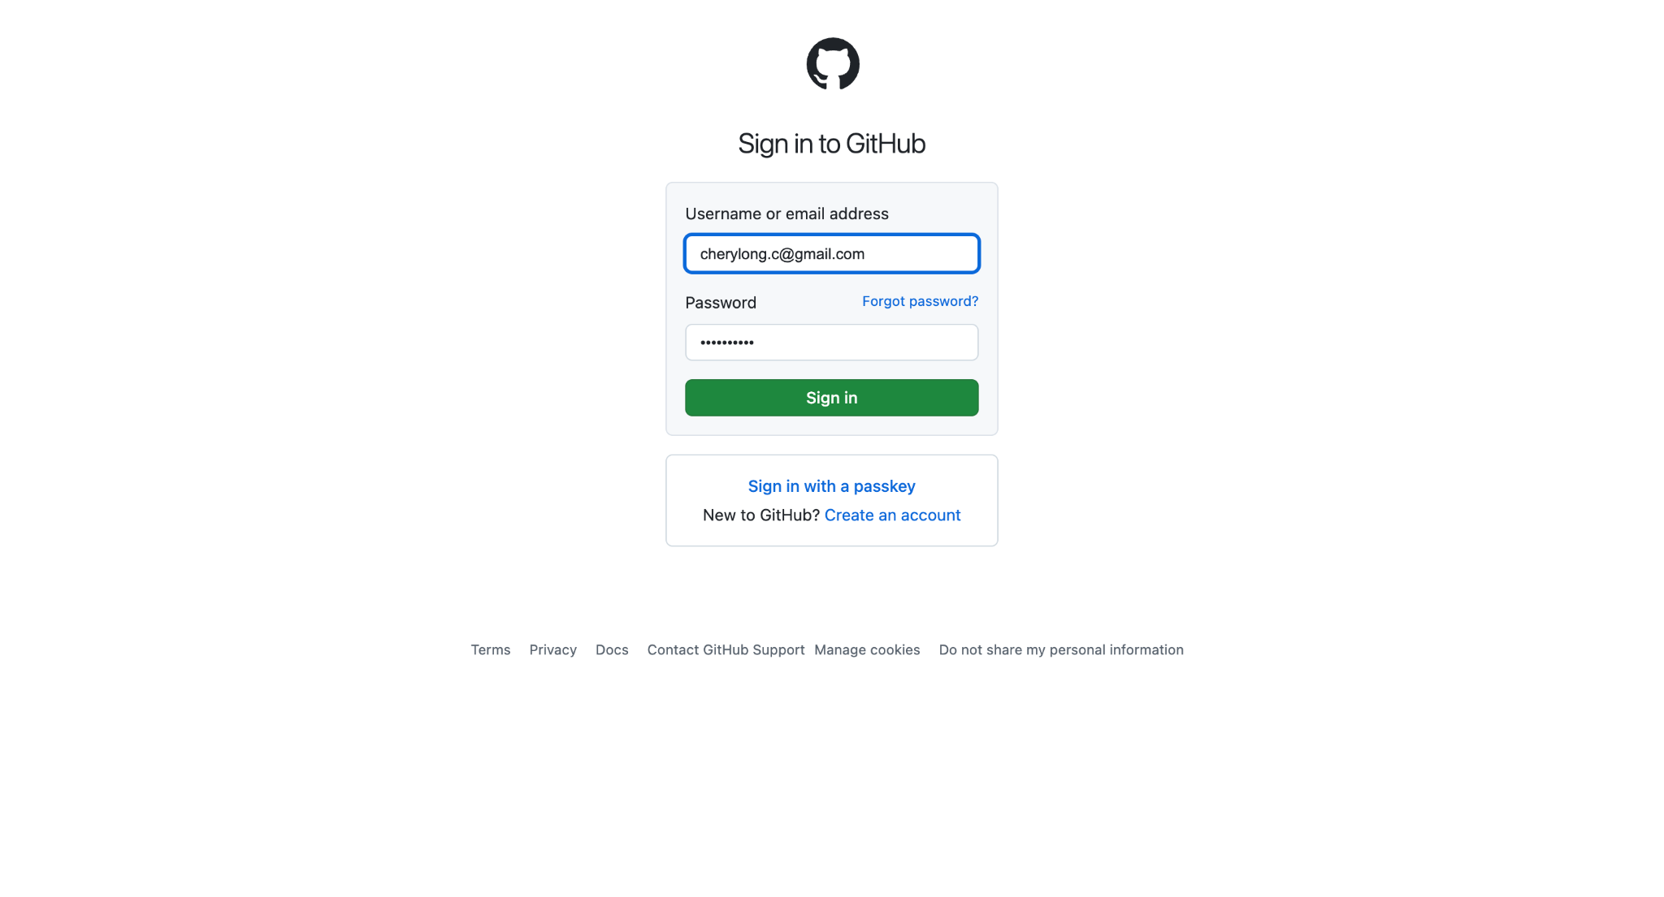
Sign in to GitHub!
dac.html
github.ipynb
abc123@gmail.com
SIM Data Analytics Club

Slide 11
dac.html
github.ipynb
Creating Your First Repository!
Click the green “New” button on your dashboard
Name your repo "hello-world"
Type a short description (e.g., "This repository is for practicing the GitHub Flow.")
Choose "Public" or "Private"
Select "Add a README file"
Click “Create repository” – Congratulations, you made a repo!
SIM Data Analytics Club

Slide 12
dac.html
github.ipynb
Adding Your First File
Let’s Add a README File ---- A README file serves as the introduction to your project. It gives visitors an overview of what your project is about, what it does, and how to use it. Think of it as the "about" section for your project.
Edit Your README.md: Navigate to your README.md file in the repository and click to open it.
Personalize Your README: Add information about yourself or the project
Save Your Changes: After editing, scroll down and click “Commit changes.” Briefly describe what you changed in the commit message box (e.g., “Updated project description”).
SIM Data Analytics Club

Slide 13
dac.html
github.ipynb
Creating and Managing Branches
What is Branching?
Branching allows you to work on new features without changing the main code.
Click the Code tab, select the dropdown for "main," type a branch name (e.g., "readme-edits"), and click “Create branch.”
Now you can make changes without affecting the main branch!
SIM Data Analytics Club

Slide 14
dac.html
github.ipynb
Making Changes and Committing
Edit Your File: Open the file in your repository and make your desired changes.
What is a Commit?: A commit saves your changes as a snapshot of your project. It allows you to track progress and revert if needed.
Write a Commit Message: Briefly describe your changes in the commit message box (e.g., “Updated project description” or “Fixed typo in README.md”).
Commit Your Changes: Click the “Commit changes” button to save your edits and record them in your project history!
SIM Data Analytics Club

Slide 15
dac.html
github.ipynb
Pull Request
A pull request is a request to merge your changes from one branch into another, allowing others to review, discuss, and suggest modifications before integrating the updates into the main project.
After making changes in your branch, you can propose these changes to be merged into the main branch by opening a pull request.
SIM Data Analytics Club

Slide 16
dac.html
github.ipynb
Open a Pull Request
How to Open a Pull Request:
Navigate to the Pull Requests tab in your repository
Click on “New pull request”
Select your branch from the dropdown menu to compare it with the main branch.
Provide Details:
Give your pull request a descriptive title that summarizes your changes.
In the description box, explain what changes you made and why. This helps reviewers understand your intentions and the purpose of your edits.
Ready for Review! Once submitted, your pull request is open for others to review, discuss, and eventually merge into the main project.
SIM Data Analytics Club

Slide 17
dac.html
github.ipynb
Merging Your Pull Request
Before merging, review your pull request to ensure everything is correct, helping to prevent potential issues in the future.
Once you’ve reviewed everything, click the “Merge pull request” button to combine your changes into the main branch.
After clicking to merge, confirm the action to proceed. This ensures you want to complete the merge.
If the branch is no longer needed, click “Delete branch” to keep your repository organized.
SIM Data Analytics Club

Slide 18
dac.html
github.ipynb
Collaborating with Others
Forking: Copying someone else’s repo to your own account; Create a copy of someone else’s repository to experiment and propose changes via a pull request
Cloning: Downloading a copy to your computer; Download a repository to your computer to work offline and test changes before pushing updates
Opening Issues: If you find a bug or have an idea to improve the project, you can open an "issue".
Commenting on Code: You can leave comments on specific lines of code in a pull request. This allows you to give feedback, ask questions, or suggest changes, making it easier for everyone to collaborate.
SIM Data Analytics Club

Slide 19
dac.html
github.ipynb
GitHub Cheat Sheet
(Next 3 slides)
A reference guide that summarizes essential Git commands for version control, helping you manage and track changes in your projects efficiently, both locally and on platforms like GitHub.
SIM Data Analytics Club

Slide 20
dac.html
github.ipynb
Basic Git Commands
Initialize a Git Repository: git init Creates a Git repository in the current directory.
Clone a Repository: git clone <remote-repo-address> Copies the entire repository from a remote server to your local machine.
Add Files to Staging: git add <file.txt> Stages files or folders, preparing them for a commit.
Commit Changes: git commit -m "Commit message" Creates a snapshot of the changes in the staging area with a message describing the changes.
Configuring Git
Set User Information: git config --global user.name "Your Name" git config --global user.email "your.email@example.com" Sets user-specific configurations like name and email.
SIM Data Analytics Club

Slide 21
dac.html
github.ipynb
Tracking and Managing Changes
Check the Status of Changes: git status Shows the list of changed files and their current state (staged, unstaged, etc.).
View Commit History: git log Displays a detailed list of commits in the current branch.
Pushing and Pulling Changes
Push Local Changes to Remote Repository: git push <remote-name> <branch-name> Sends local commits to a remote branch.
Pull Latest Changes from Remote: git pull Merges changes from a remote repository into your local directory.
SIM Data Analytics Club

Slide 22
dac.html
github.ipynb
Branching
Create and Switch to a New Branch: git checkout -b <branch-name> Creates a new branch and switches to it.
Delete a Branch: git branch -d <branch-name> Deletes a specified branch.
Remote Management
View Remote Repositories: git remote -v Lists the URLs of the remote repositories connected to your project.
Add a New Remote Repository: git remote add <remote-name> <host-or-remoteURL> Adds a new remote server to your local repository.
Merging and Resolving Conflicts
Merge a Branch into Current Branch: git merge <branch-name> Combines changes from one branch into the current branch.
SIM Data Analytics Club

